Slide 1
Building Always On Availability Groups Using PowerShell

Slide 2

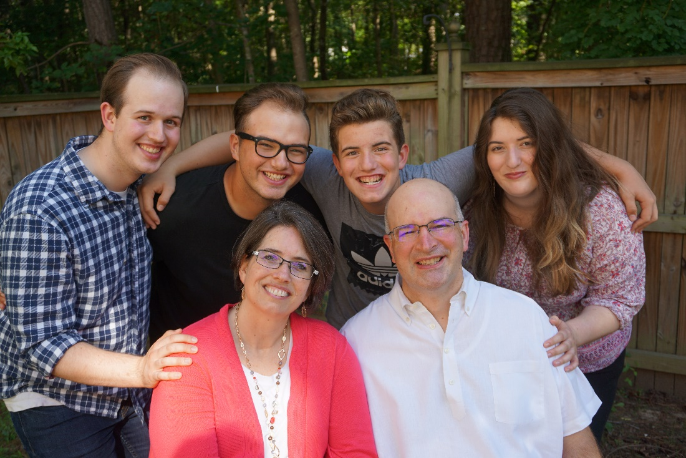
About Speaker
Operational and Automation Focus
Started Working w/SQL Server in 2008
Former SAN and Exchange Admin Twitter: @nanoDBA Lars.Rasmussen@gmail.com
Notes:
automation of operational processes w/PowerShell
Yes, I am a St Louis Cardinals fan

Slide 3
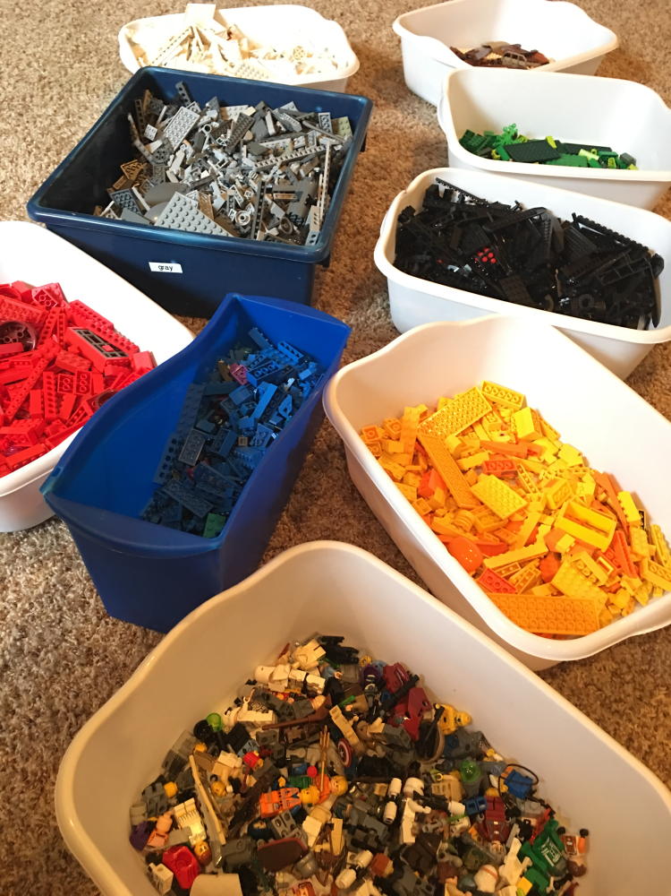
Notes:
Systems are made up of lots of pieces

Slide 4
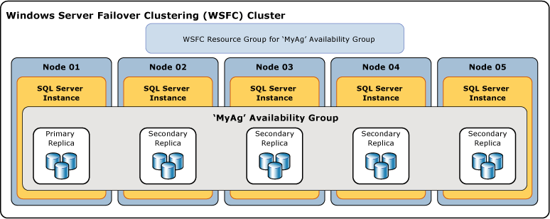
Always On Availability Groups

Slide 5

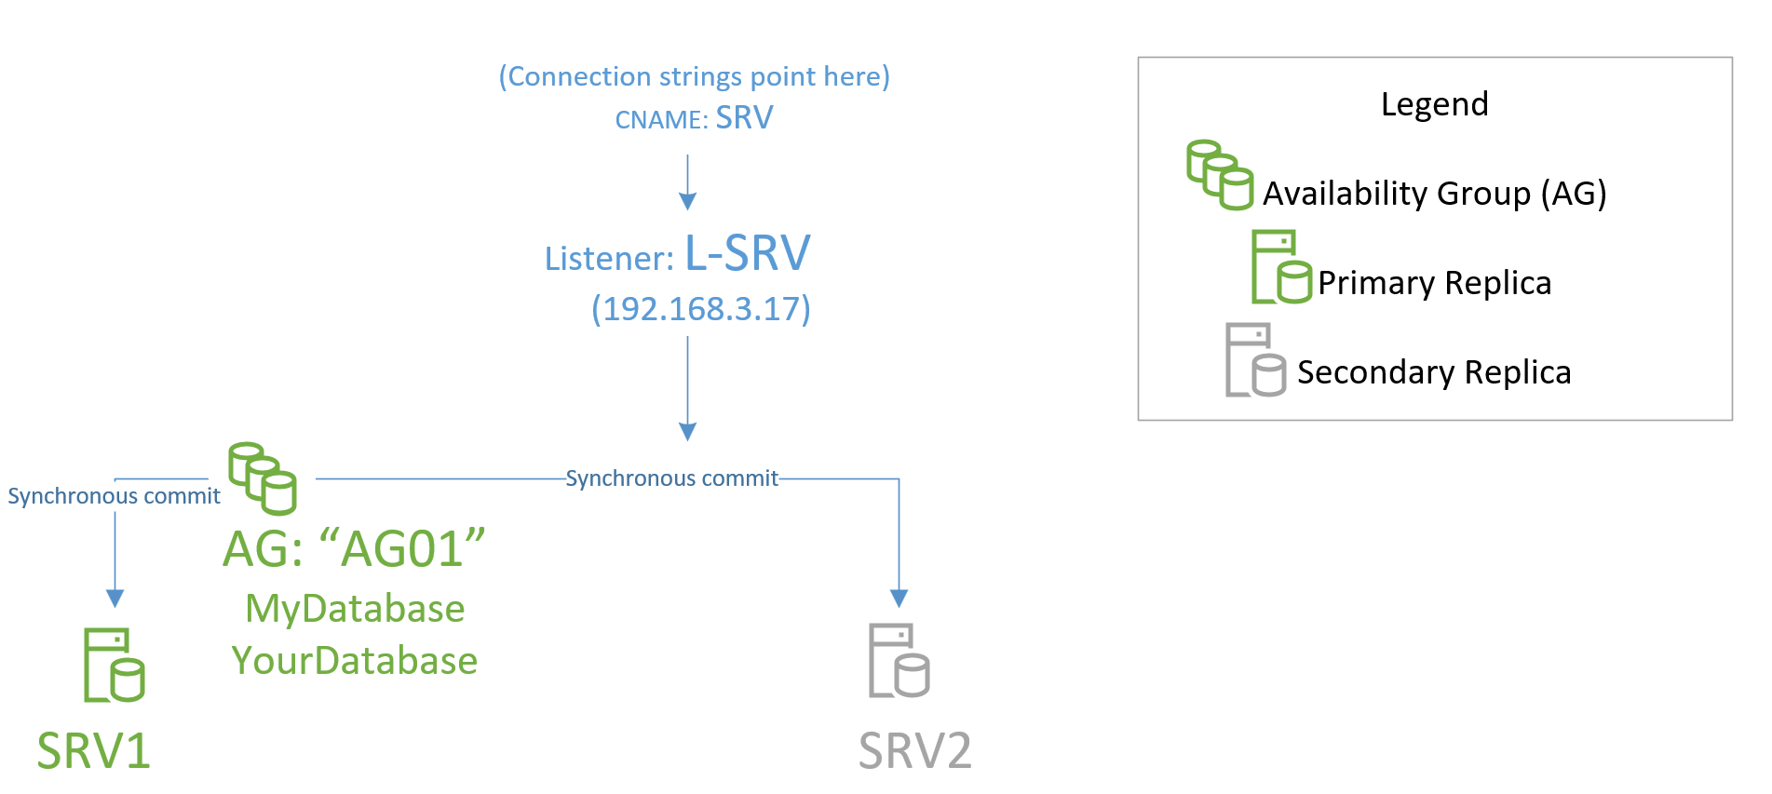

Slide 6
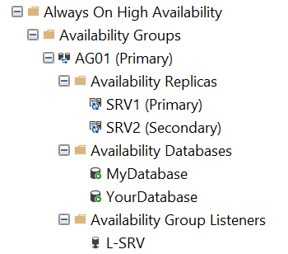

Slide 7
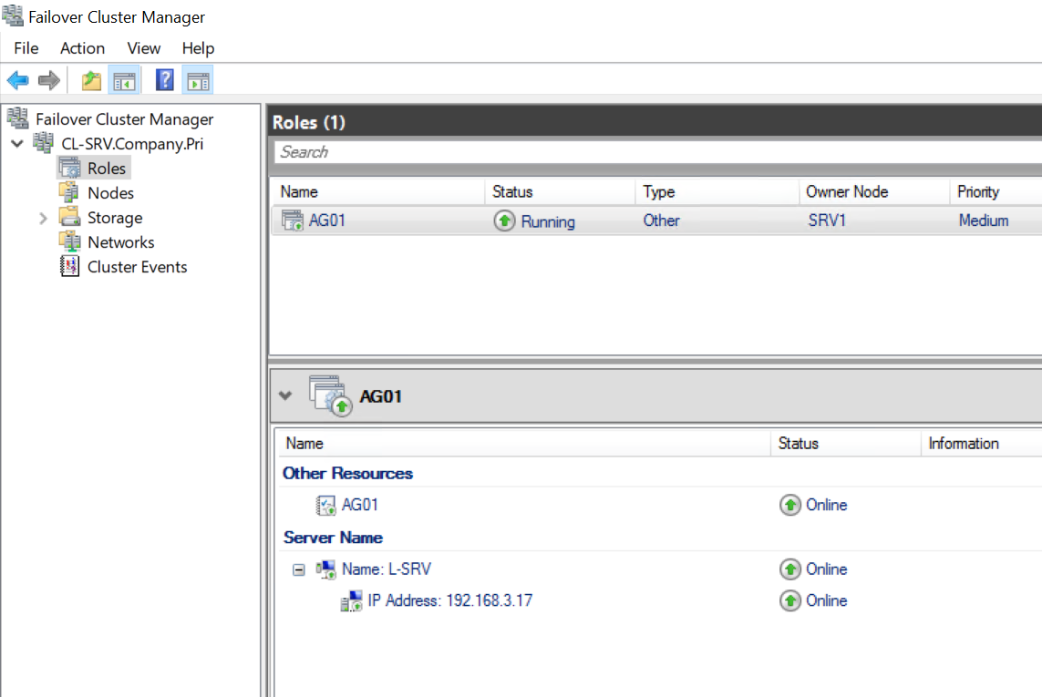

Slide 8
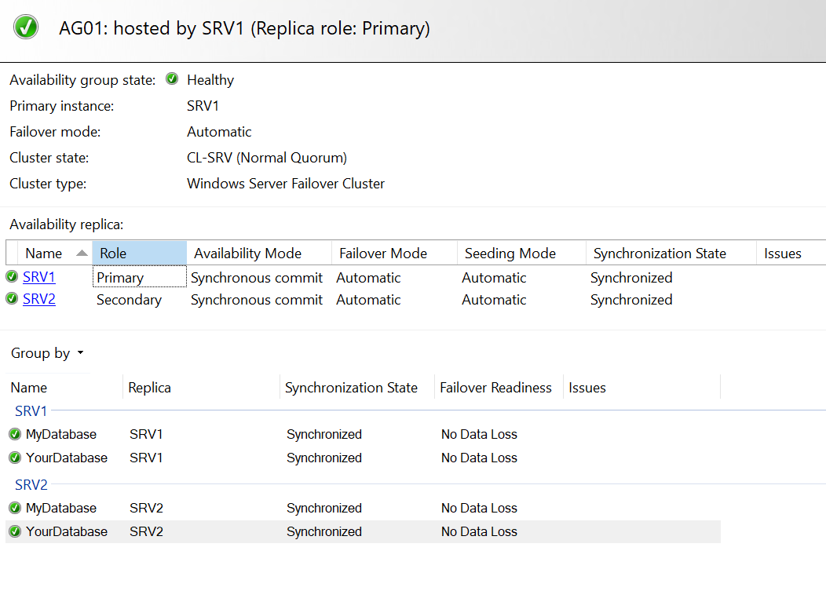

Slide 9
DEMO! Scripts posted at:
github.com/nanoDBA/demos

Slide 10



Gotchas, potential dangers…

Slide 11

Happy because HIGHLY AVAILABLE!

Slide 12
Scripts posted at:
github.com/nanoDBA/demos

Slide 13
Thank YOU!
github.com/nanoDBA/demos
Twitter: @nanoDBA Lars.Rasmussen @ gmail.com
Notes:
Questions? Experiences?

